Slide 1

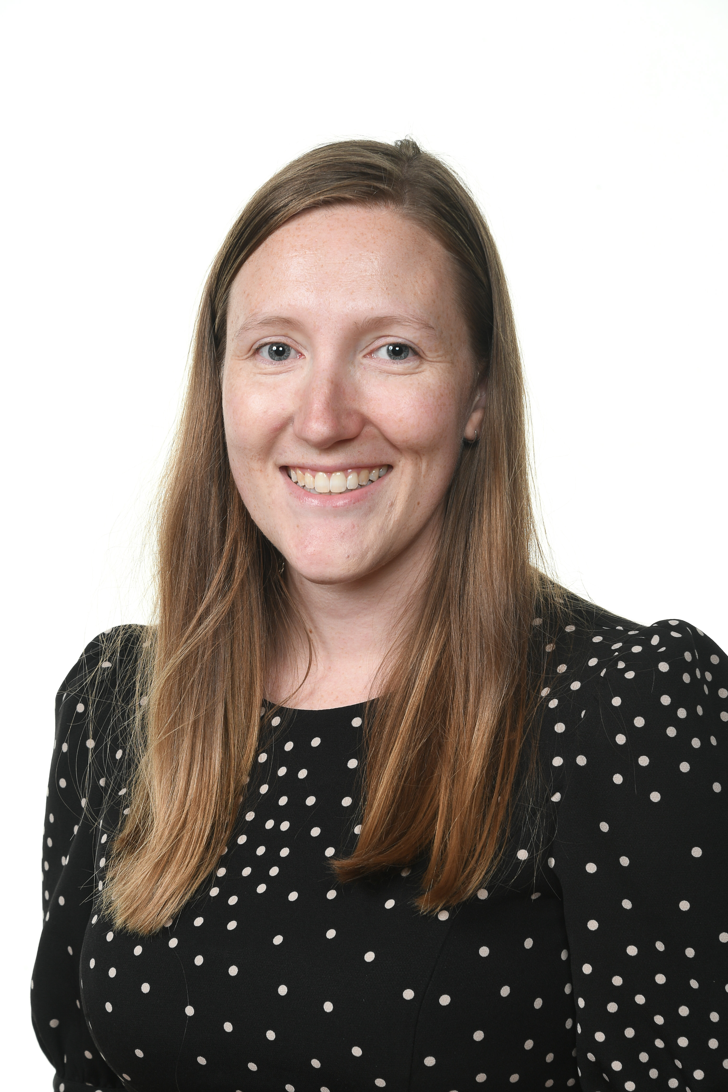
Open and honest communication
Appropriate and effective teaching and learning
A partnership approach
St Joseph’s Catholic Primary School
Special Educational Needs Offer
Hello and welcome to St Joseph’s Catholic Primary School, Special Educational Needs area of our website.
My name is Mrs West and I am the SENDCO (Special Educational Needs and Disabilities Coordinator).
If you think your child has special educational needs, read on to see what St. Joseph’s can offer you.
Mrs West is in school on a Tuesday, Wednesday and Thursday and you can contact her on
0121 464 8140 or by email at senco@stjosb7.bham.sch.uk

Slide 2
Open and honest communication
In this section, you can find out about:
How to speak to the SENDCO, if you have a concern.
How we try to make the information about your child clear and easily understood.
Which agencies might become involved with your child.
How we ensure the necessary people know about your child’s needs.
What happens when your child moves school.
Notes:
These will then link to the other areas

Slide 3
Open and honest communication
If you have a concern about your child, Mrs West is available to speak to you.
We always encourage you to speak to your child’s teacher too.
Mrs West works in school on Tuesday, Wednesday and Thursday. Sometimes she may be teaching or she might not be in the building so you can do the following:
An appointment can be made via Mrs Ashley or Mr Caffrey.
Make an appointment to see Mrs West or ask if she can telephone you.
You can also email her at senco@stjosb7.bham.sch.uk
We operate an open door policy and you are welcome to come into school.
We hold regular termly meetings with parents during the day so that you can find out how your child is doing in school.
Notes:
Could this be opened up under – how to speak/contact the SENDCO if you have a concern

Slide 4
Open and honest communication
We will make all the information we need to share with you clear and easy to understand.
Our SEND Policy is available on our Policies page under the Parents Information tab. The policy explains how we identify and assess children who we think might have special educational needs.
If you prefer information on paper, please ask for a copy of our Special Educational Needs Policy. Mrs Farnan (in our school office) will be able to give you a copy.
Our governing body has a governor who is responsible for special educational needs. His name is Rev Dr Dirk Hermans.
Notes:
Could this be linked to clear information

Slide 5
Open and honest communication
What happens if there is a concern
about my child’s progress?
A Teacher or parent raises a concern about a child’s progress
We will meet to produce a plan of support in school.
Provision is made to support the child’s learning – input from teacher, pupil, parent and SENDCO
If there are still concerns then the SENDCO arranges for some external agency support

Slide 6
Open and honest communication
St Joseph’s works with a lot of external agencies to help identify specific needs. Some of these are:
Pupil and School Support (PSS)
Educational Psychologist (EP)
Communication and Autism Team (CAT)
WMSLT Speech and Language Therapy (SALT)
NHS Speech and Language Therapy (SALT)
Physical Disabilities and Sensory Support (PDSS)
NHS School Nurse
Special School Outreach Service (SSOS)
If your child requires support from these services, school will always consult you and request written permission.
Notes:
Link to outside agencies

Slide 7

Open and honest communication
If school thinks your child needs extra support, we will always talk to you about this.
Your child’s teacher will talk to you about the progress that has been made each term. We also operate an open door policy and you can make an appointment to speak to your child’s teacher or the SENDCO at any point during the year.
If your child has individual targets, these will be discussed and reviewed regularly with you and your child.
If your child has more complex needs, then we may review your child’s progress and needs through a ‘Person-Centred Review’. This approach very much values the views of the child, the parents as well as the school.
Notes:
All necessary people have the info relating to your child.

Slide 8
Open and honest communication
Your child’s progress will be reviewed regularly and you will be invited into school to discuss the outcomes and give your views. Your child’s views will also be listened to.
If your child has an Individual Target Plan (ITP) and you move your child to another school, the SENDCOs at both schools make sure that information is shared.
If your child is at Nursery School and is about to start in Reception here, we liaise with the SENDCOs at the nursery schools to find out as much information as possible about your child’s needs. This will include any targets and paperwork or agencies which might have been involved in supporting your child.
When your child moves from Year 6 to secondary school, Mrs West will ensure that all information regarding your pupil’s special educational needs are passed on to the new SENDCO. Extra visits to the secondary school may be arranged and sometimes the new SENDCO will come to review meetings held at St Joseph’s.
Return to Introduction
Notes:
All necessary people have the info relating to your child.

Slide 9
Appropriate and effective teaching and learning
In this section you can find out:
How we train staff to support the needs of your child.
How we ensure high quality teaching for your child and how we give extra support if your child needs it.
How we ensure that parents and children with additional needs are fully included in all school activities.
How we ensure that your child has work pitched at the right level to make good progress.
What resources does the school offer if my child has significant social and/or communication needs?
What sorts of learning resources are available for your child.
What support is available if my child needs support with managing behaviour or dealing with social situations?
Notes:
These will then link to the other areas

Slide 10
Appropriate and effective teaching and learning
All school staff will receive appropriate training so they have the knowledge and confidence to support children’s needs.
At St Joseph’s we hold a weekly staff meeting. These are used to ensure staff have up-to-date knowledge to teach children of all abilities. Sometimes training is run by specialists e.g. a classroom strategies session delivered by the Communication and Autism Team.
Or if a specific year group or member of staff requires additional support, bespoke training may be delivered to just them.
Particular support is given to newly qualified, ECT teachers and other members of staff who are new to our school.
Notes:
All necessary people have the info relating to your child.

Slide 11
Appropriate and effective teaching and learning
We offer support through some key interventions. We identify the children by looking closely at their progress and what we can do to support them.
Maths Toolkit, On Track Maths
These interventions are aimed at improving basic number skills.
‘Toe by Toe’ programme, Word Wasp, On Track English
These interventions are aimed at improving basic reading and English skills.
WellComm
This intervention is aimed at improving speech and language skills in EYFS and KS1.
Teachers and TAs work closely together so children can apply what they have learnt in lessons
Notes:
All necessary people have the info relating to your child.

Slide 12
Appropriate and effective teaching and learning
Here are some comments made by children who have participated in our interventions.
I like reading with Mrs Dalziel. She helps me with my phonics and makes it fun!
Miss Crane helped me to get better at my number bonds and my doubles and halves. We played lots of games!
Mrs Bailey lets me choose books to read and I can write about them. I can write lots of sentences on my own now with Mrs Bailey and in my classroom.
Notes:
All necessary people have the info relating to your child.

Slide 13
Appropriate and effective teaching and learning
Teaching and support staff will be able to accurately assess the level children are working at and adapt the curriculum appropriately.
We use a range of criteria and evidence to help us identify the level children are working at. This might include:
Checking the words children can read and spell independently
Moderating writing together
Making observations, particularly regarding speaking and listening and Maths
Use of tests, where appropriate
This helps teachers to plan work for all children to make progress. The work and support will be different for different groups of children.
We use the following to support
children with additional needs to
become independent learners
Interventions
One to one or group support
Support of the Toolkits
Adapted tasks and resources
Children’s work is regularly looked at by the SENDCO and the Senior Leadership team
Notes:
All necessary people have the info relating to your child.

Slide 14
Appropriate and effective teaching and learning
A range of resources will be available in all learning areas to support learning for children operating at different levels. These are identified on children’s Individual Target Plans (ITPs).
Our reading books, in class and to take home, are book banded so that they are at the right level for your child to make progress.
We have a range of assistive technology including laptops, iPads, kindles and recording equipment to support children recording their work in different ways across the school environment.
Positions of tables and chairs are always considered for children with physical, hearing or sight impairment.
Reading materials are enlarged for children with sight impairment.
Our working walls have examples of teacher models to support independent learning.
Children are encouraged to talk with partners or in small groups to develop their ideas, reason and articulate before recording them.
Notes:
All necessary people have the info relating to your child.

Slide 15
Appropriate and effective teaching and learning
Where necessary, resources will be available to support the learning of children who have significant social and/or communication needs.
Our Provision Plans, Individual Target Plans, Individual Behaviour Plans and Pupil Profiles identify the types of need a child may have. For example, Communication and Interaction or Cognition and Learning.
We use visual timetables in all classrooms, so that children understand the structure of the school day. This supports children who have difficulties with changes in routine.
We work with the Communication and Autism Team. Members of the team visit to observe, assess and offer advice on ways to support children with a diagnosis of Autism, or children who are on the pathway to diagnosis..
We can provide individual workstations for a pupil whose needs require them.
Notes:
All necessary people have the info relating to your child.

Slide 16
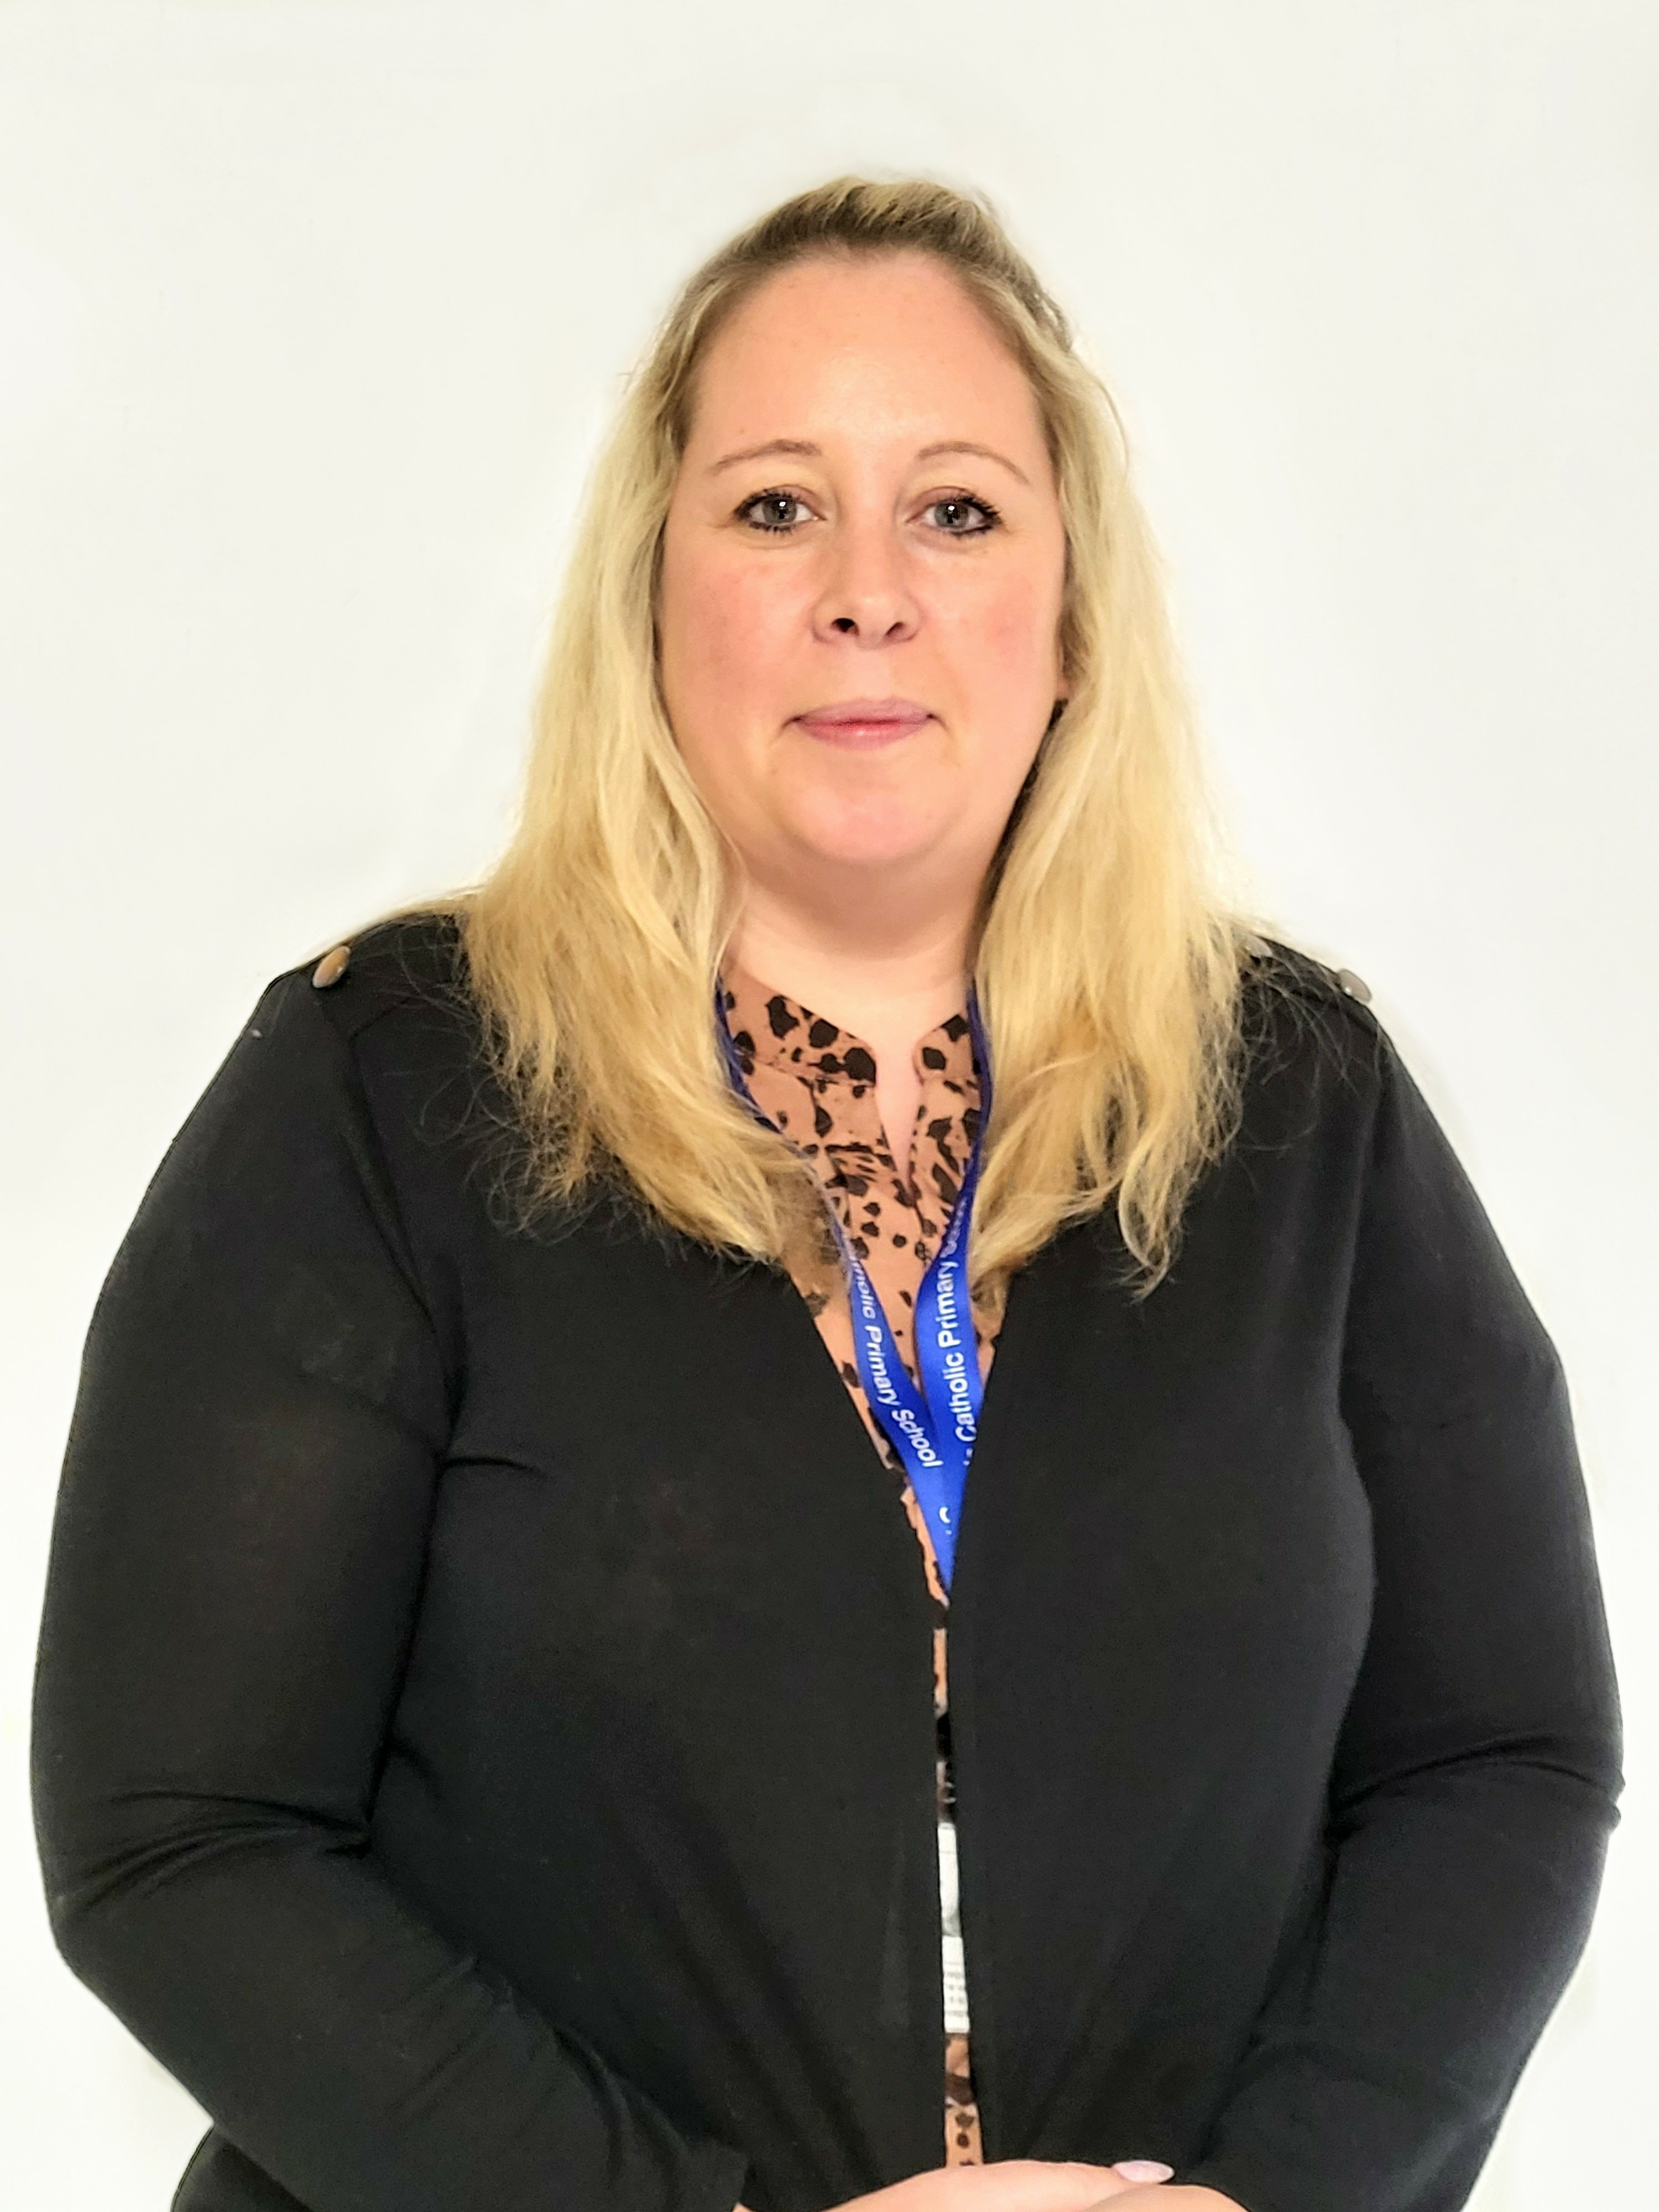
Appropriate and effective teaching and learning
The school will provide support for children if they need support with managing their own behaviour and/or to build up skills and confidence in dealing with social situations.
We work with our Educational Psychologist who can provide support for pupils who have difficulty in managing their behaviour.
We run social skills groups and nurture groups across the school to support children who can find social situations difficult.
We have a set of sanctions and rewards, as set out in our Behaviour Policy to encourage children to make the right choices. This is consistent across the school. Our Behaviour Policy is available on our ‘Policies’ page under the ‘Parents Information’ section.
Mrs Gowen is our Pastoral Lead. She works with pupils and families to support their social, emotional, mental health and well-being.
Mrs Gowen
Pastoral Lead
Notes:
All necessary people have the info relating to your child.

Slide 17
Appropriate and effective teaching and learning
The school will try to make sure that children with additional needs and their families are able to take part fully in school trips and social events.
Our school mission statement is
“Jesus light our way on our faith journey. Be our guide, our joy and our hope as we learn, live, love and pray together.”
This statement underpins our ethos of inclusion at St Joseph’s School.
The school curriculum includes trips out to enrich the experiences children have. Children with additional needs are often in this group. Our risk assessments are inclusive of SEND children and one to one adult support is provided, should this be required. Parents are consulted regarding specific needs, including those children with medical needs, so that all children have a safe and enjoyable experience.
All children participate in performances, such as musical performances. When we have outside theatre companies in to perform, the additional needs of pupils are considered. Whenever possible, all children join in unless participation, especially around noise level, may cause the child distress and anxiety. We will provide these children with alternative provision.
Children with additional needs have the opportunities to participate in after school clubs. You just have to apply!
Notes:
All necessary people have the info relating to your child.

Slide 18
Appropriate and effective teaching and learning
The school will provide high quality teaching for your child and extra support where needed.
St Joseph’s uses a range of strategies to monitor the progress of children and to ensure that good teaching is in place for all pupils.
We do this through:
Tracking your child’s progress and holding teachers to account through termly pupil progress meetings.
Frequent book looks for all classes and constructive feedback to teachers.
Classroom observations and learning walks, including monitoring of the learning environment.
Return to Introduction

Slide 19
A partnership approach
In this section, you can find out:
How we will work with you to identify your child’s needs.
How we will ask for your permission to involve other professionals to work with your child.
How we will involve you in all decisions and listen to your views.
How we will involve your child in decisions about their learning.
How we can support you in contacting organisations who can give advice and support.
Notes:
These will then link to the other areas

Slide 20
A partnership approach
We will work in partnership with you to identify the needs of your child and put in place the correct support including family support if you need this.
The governing body has a duty to ensure that the school adheres to SEND Code of Practice: 0-25 years. This means that the school governors hold the Headteacher, Mrs Ashley and SENDCO, Mrs West to account.
The governing body appoints a governor who is specifically responsible for special educational needs to ensure that the school and the SENDCO carry out their duties. This governor is Rev Dr Dirk Hermans.
One of the key responsibilities of the governing body is to make sure that the school’s policy for children with Special Educational Needs and Disabilities (SEND) is published on the school website. The information on the school website must be reviewed annually by the governing body.
Our SEN and Behaviour Policies are available on our website on the ‘Policies’ page under the Parents Information section.
The governing body also has a responsibility to ensure that appropriate safeguarding procedures are in place for all pupils, including those who are SEND.
Notes:
All necessary people have the info relating to your child.

Slide 21
A partnership approach
Sometimes we may need to ask for your permission to involve other qualified professionals to support your child.
The governing body, through the SENDCO, ensures that other appropriate agencies are involved in meeting the needs of pupils with special educational needs.
The governing body regularly reviews both policy and the information published on the website to ensure it is up-to-date, parent and pupil friendly and in line with government policy and the Code of Practice.
When another qualified professional works with your child, permission is sought, and when granted the member of the outside agency is introduced. The content of the meeting is confidential and is only shared with parents and the SENDCO.
Please speak to Mrs West if you require any further information about this.
Notes:
All necessary people have the info relating to your child.

Slide 22

A partnership approach
The school will involve you in all decisions and listen to your views.
1. Parents or teachers raise a concern about the progress of a child. Discussion with parents/ teacher/ SENDCO takes place.
2. Assessments are carried out to find out the specific need(s) of the child.
Possible involvement of outside agency.
Ways to support at home discussed.
5. Outcomes are assessed and reviewed with the parents and the child – what’s worked well, what still needs to be worked on.
3. Targets to address the needs are written with parents and pupils. Resources and teaching approaches are identified. Individual Target Plan or Behaviour Plan is implemented.
4. Teaching with regard to the Individual Target Plan, takes place. Appropriate support/interventions are included and progress is monitored with the child.
Concerns are addressed. Continued progress to be monitored.
Notes:
All necessary people have the info relating to your child.

Slide 23

A partnership approach
The school will try to involve your child in
decisions about their learning.
Here are the things we do at St Joseph’s to make sure your child is listened to and involved in decision making:
Our voice!
Pupil voice
Being involved in target setting and saying how well we’ve done.
One page profiles
Open door policy – We can speak to the Head, Deputy or SENDCO, Pastoral Lead as well as out class teacher.
Being involved in reviewing our progress in interventions.
Person-Centred Reviews
Notes:
All necessary people have the info relating to your child.

Slide 24
A partnership approach
We will be happy to give you contact details for organisations who can give advice and support for you and your child.
Please speak to Mrs West if you need any other contact details.
Local Authority Support Services:
Communication and Autism Team
Tel: 0121 303 1792
Pupil and Support Services
Tel: 0121 303 1792
Behaviour Support Service (BSS)
Tel: 0121 303 0272
Team for children with physical difficulties PDSS
Tel: 0121 303 0464
SENAR
Tel: 0121 675 8085
Health Services:
School Nurse Service
Tel: 0121 466 6266
Child Development Centre Tel: 0121 507 9500
Speech and Language Therapy Tel: 0121 466 3370
Social Services and Voluntary Organisations:
Childrens Services
Tel: 0121 303 1888
Child and Mental Health Services (CAMHS)
Tel: 0121 333 9193
Action for Children
Tel: 0121 507 9500
SENDIASS
Tel: 0121 303 5004
Return to Introduction
Notes:
All necessary people have the info relating to your child.

